Slide 1
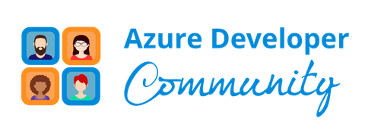
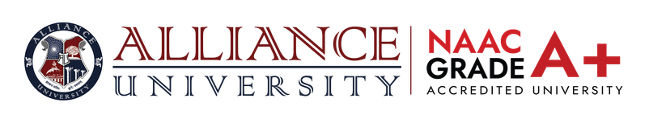

CODEVEDA - HACKATHON 2026
Problem Statement Title: Real-Time Workforce & Field-Risk Intelligence for High-Risk Industries
Theme: AI & IoT for Smart Industrial Safety
Team Name: CTRL+ Innovators
Team Leader’s Name: Saniya Ilma
Team Members Name : Charan G, Preetham Shetty, Dhanya M, Muskan Kumari
.
Alliance School of Advanced Computing | Microsoft Azure Developer Community 1

Slide 2

IDEA TITLE
SafeSense AI – Intelligent Worker Safety Monitoring System
Proposed Solution:
An AI-powered IoT safety monitoring system that continuously monitors workers and workplace conditions to detect hazardous situations and prevent accidents in real time.
Detailed Explanation:
• Sensors monitor gas concentration, temperature, and worker health parameters • Data is collected using ESP32 microcontroller • Data is transmitted to Azure cloud platform • AI model analyzes data to classify risk level • Safety dashboard displays SAFE / WARNING / DANGER status
How It Addresses the Problem:
• Provides real-time monitoring of hazardous environments • Enables early detection of dangerous conditions • Allows supervisors to take preventive action before accidents occur
Innovation & Uniqueness:
• Combines IoT sensors + AI predictive analytics • Uses cloud-based real-time monitoring • Focuses on predictive safety instead of reactive safety
ASAC
2
Alliance School of Advanced Computing | Microsoft Azure Developer Community 2
Notes:
2

Slide 3
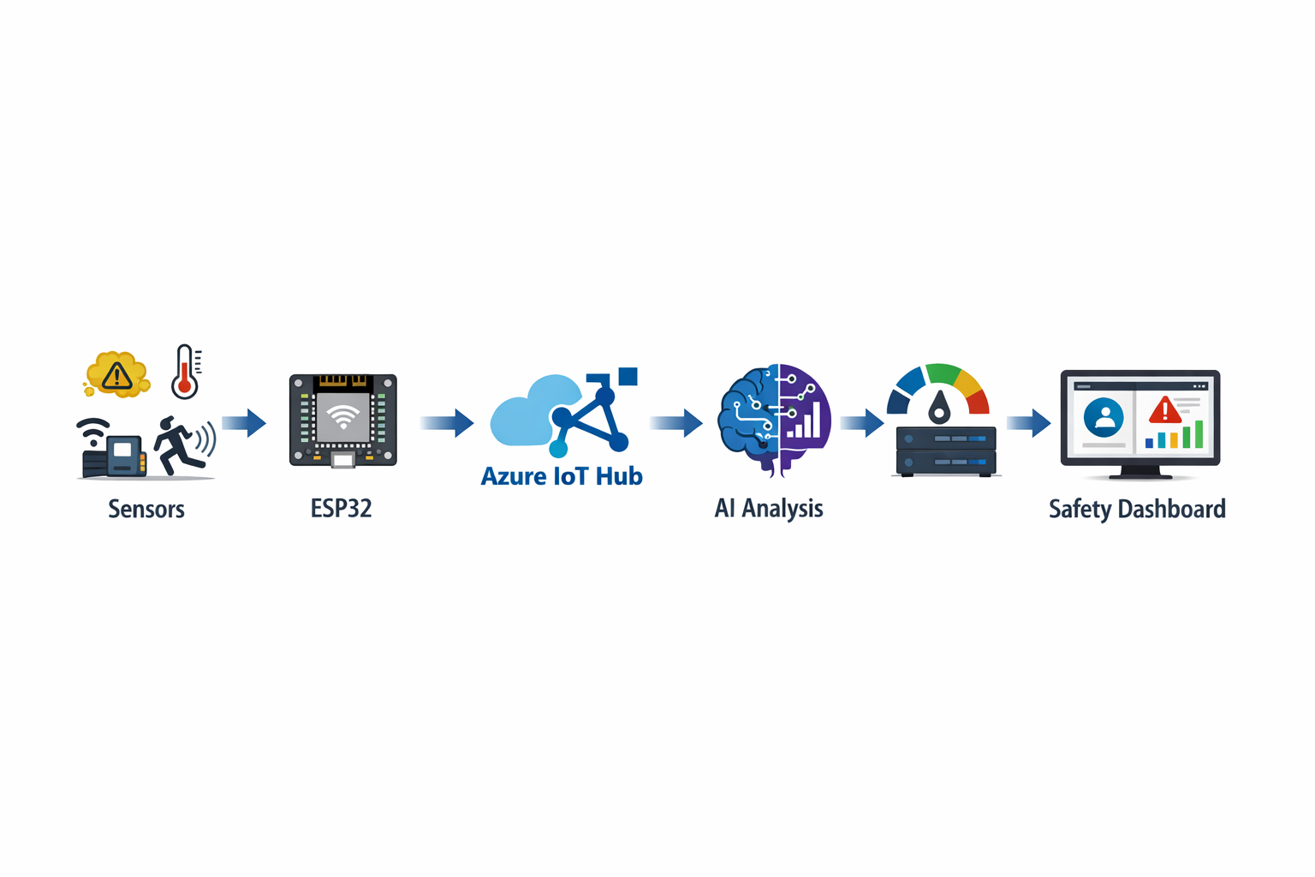
TECHNOLOGY & METHODOLOGY
Technologies Used
Hardware: • ESP32 Microcontroller • Gas Sensor • Temperature Sensor • Heart Rate Sensor (optional wearable)
Software: • Python (Flask backend) • HTML / JavaScript Dashboard
Cloud Platform: • Microsoft Azure IoT Hub • Azure Stream Analytics • Azure Machine Learning
Methodology / Implementation Process
→Sensors collect environmental and worker health data →ESP32 processes sensor readings →Data is transmitted to Azure IoT Hub →Azure services analyze data in real time →AI model predicts risk levels →Dashboard shows live safety status and alerts
Alliance School of Advanced Computing
3
Alliance School of Advanced Computing | Microsoft Azure Developer Community 3
Notes:
3

Slide 4
FEASIBILITY AND VIABILITY
Feasibility Analysis:
• Uses low-cost IoT hardware • Cloud infrastructure handled by Microsoft Azure • Easily scalable for large industrial environments
Potential Challenges:
• Sensor accuracy and calibration • Network connectivity issues in remote locations • Handling large-scale sensor data
Strategies to Overcome Challenges:
• Regular sensor calibration • Use edge processing with ESP32 • Implement scalable Azure cloud services
Scalability:
System can be deployed in:
• Construction sites • Mining industries • Manufacturing plants • Disaster response operations
Alliance School of Advanced Computing
4
Alliance School of Advanced Computing | Microsoft Azure Developer Community 4
Notes:
4

Slide 5
IMPACT AND BENEFITS
Target Audience:
• Industrial workers • Safety supervisors • Construction companies • Mining and manufacturing industries
Social Impact:
• Improves worker safety • Reduces workplace accidents • Enables real-time hazard detection
Economic Benefits:
• Reduces accident-related costs • Minimizes operational downtime • Improves workplace productivity
Environmental Benefits:
• Detects gas leaks and hazardous emissions • Supports safer and sustainable industrial environments
Alliance School of Advanced Computing
5
Alliance School of Advanced Computing | Microsoft Azure Developer Community 5
Notes:
5

Slide 6
RESEARCH AND REFERENCES
Research Inspiration:
• IoT-Based Industrial Safety Monitoring Systems • AI-Based Workplace Hazard Prediction • Wearable Health Monitoring Systems
Technology References:
• Microsoft Azure IoT Hub Documentation • Azure Machine Learning Services • ESP32 IoT Development Framework
Alliance School of Advanced Computing
6
Alliance School of Advanced Computing | Microsoft Azure Developer Community 6
Notes:
6

